Slide 1
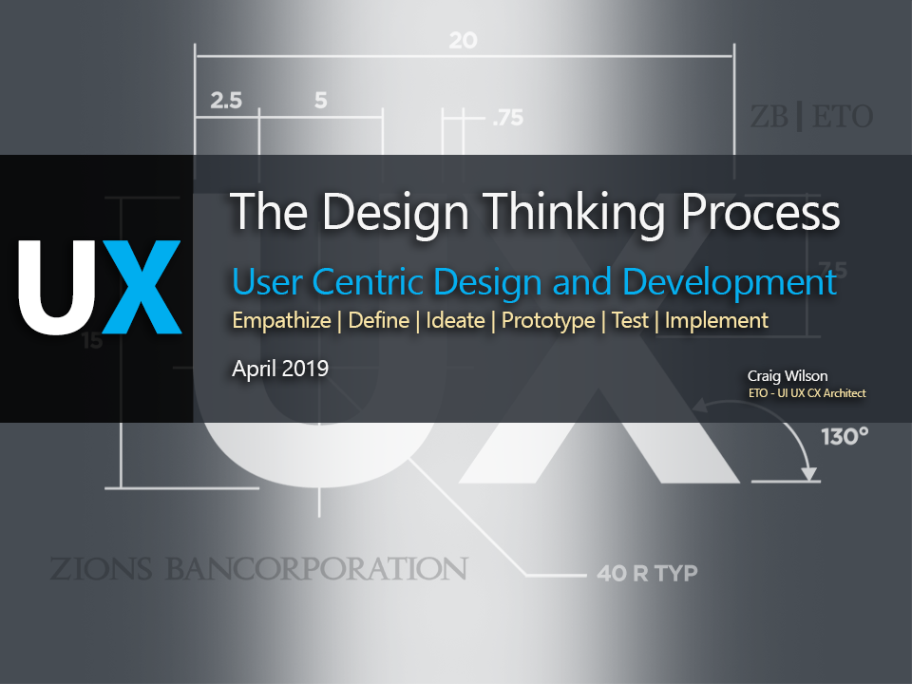

Slide 2






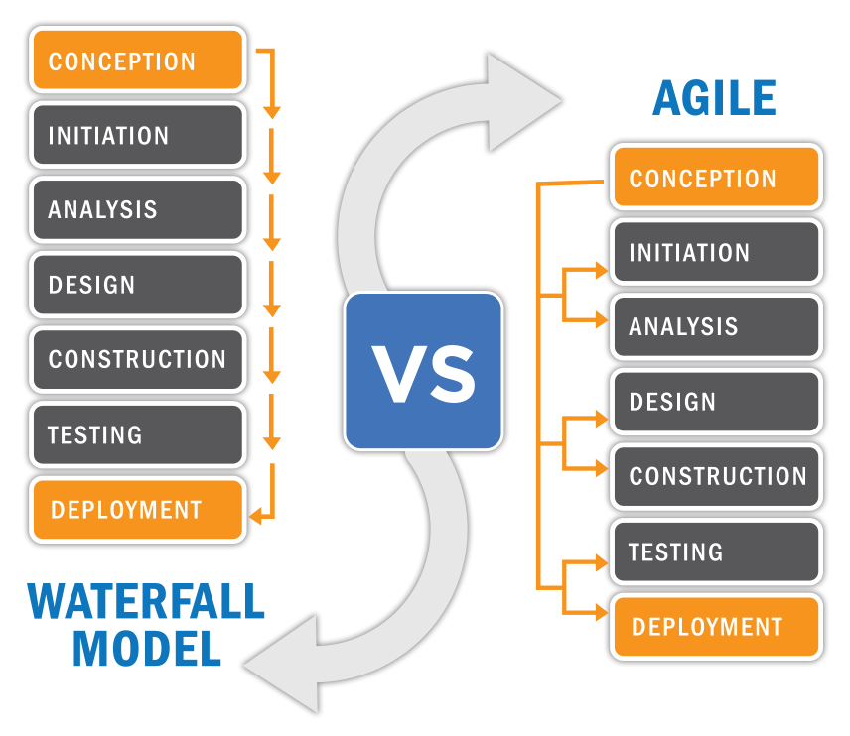
Waterfall vs Agile

Slide 3
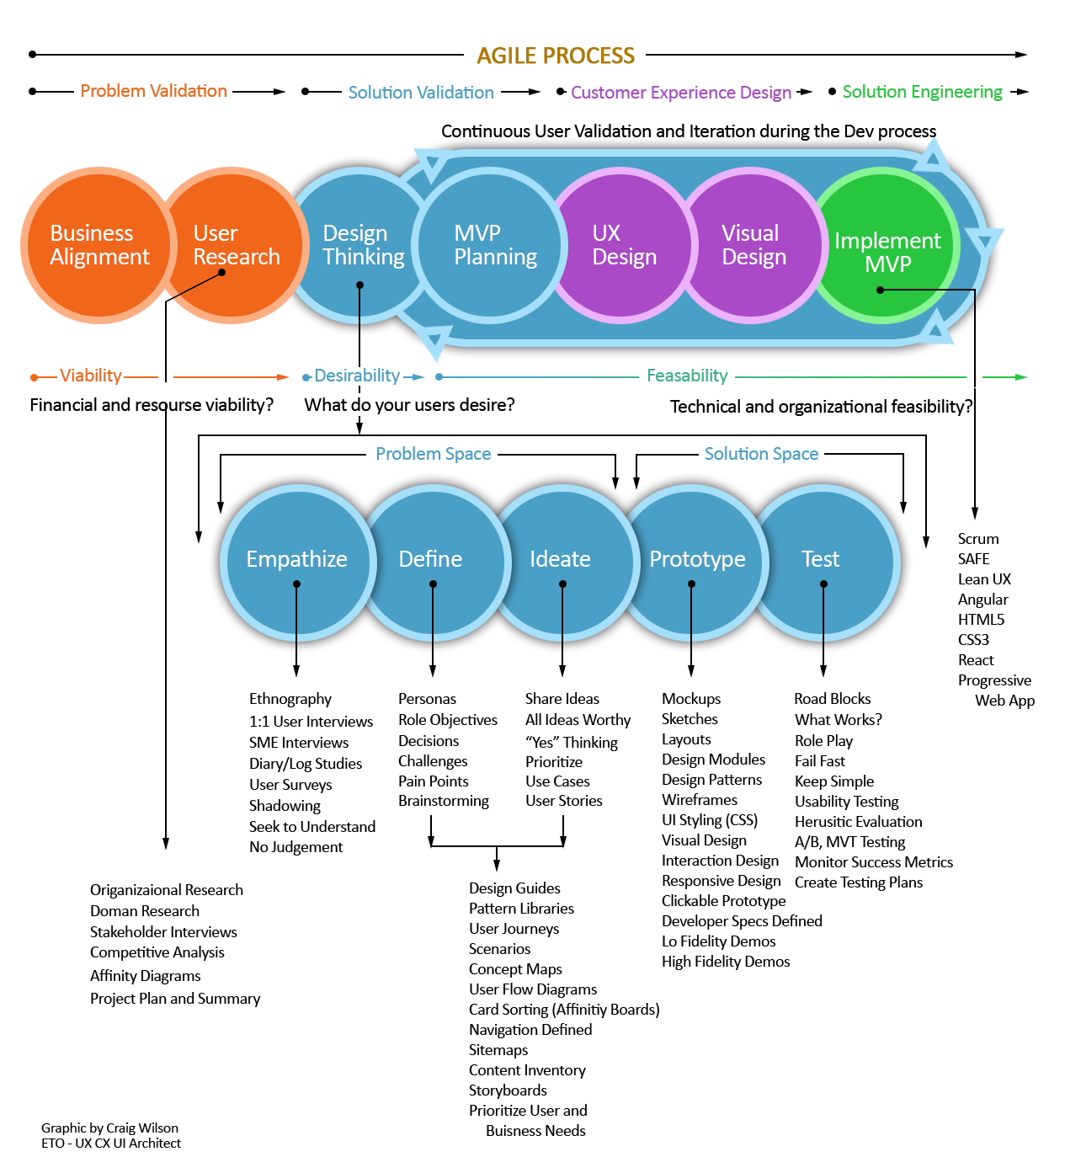
Software Development Process

Slide 4
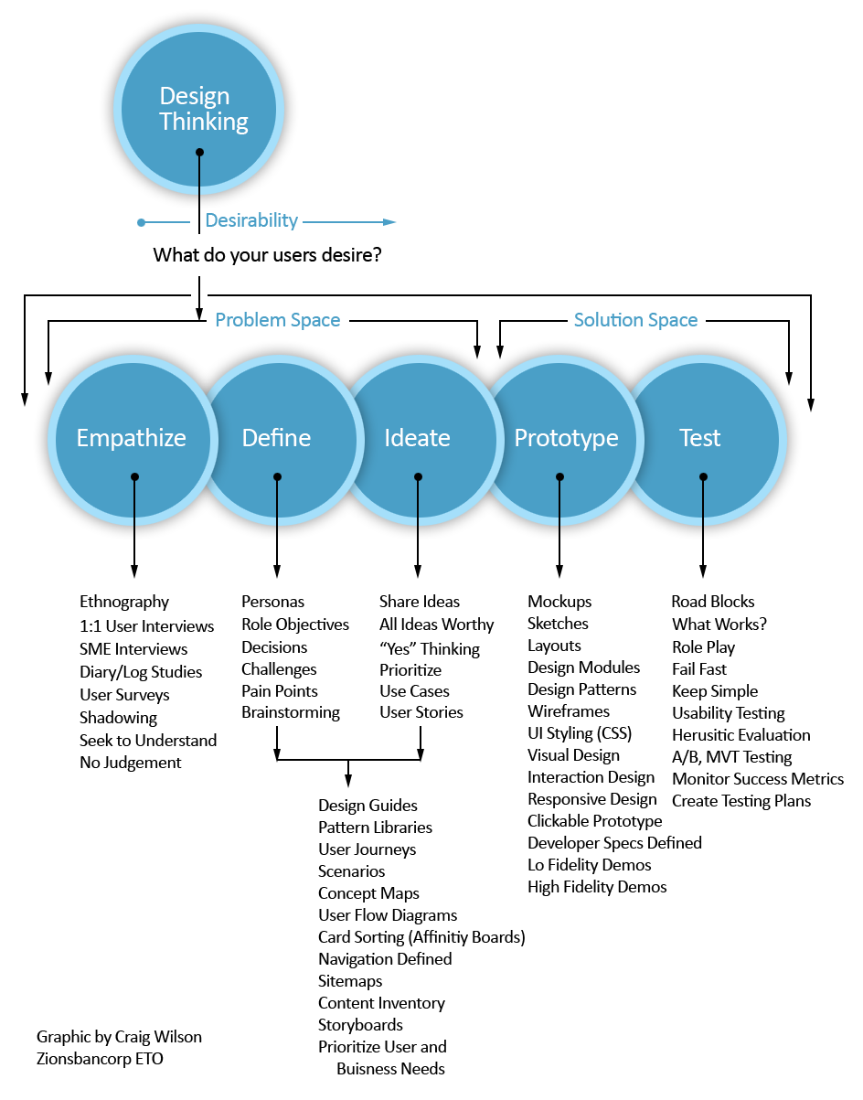
Focus : Design Thinking Stages

Slide 5
UX Vision Statement First Draft
What is our Vision?
To deliver intuitive, efficient, and visually appealing digital experiences
that empower employees to better serve our customers, help customers
effectively run their businesses, and achieve their personal financial goals.
We accomplish this by gaining a deep understanding of our targeted users
and their key journeys and challenges. Using the Agile Software Development
Process, we validate the needs of our targeted users to deliver products
that bring delight as they progress in their target journeys.
How do we accomplish this?

Slide 6
What is Design Thinking?
Design Thinking is a human-centered approach to
problem solving.
Helps us to get a deep understanding of customers’
unmet needs and wants.
It encourages creative consideration of a wide array
of Innovative solutions.
It is as much a mindset as it is a process.

Slide 7
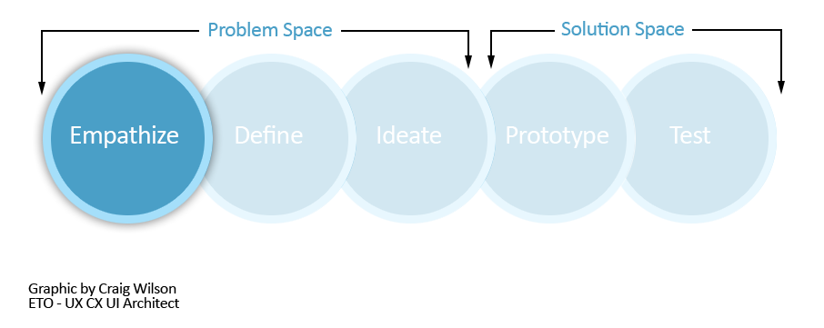
Stage 1 : Empathize
The first stage of the Design Thinking process is to gain an empathic understanding
of the problem we are trying to solve. Empathy is crucial to human-centered design
processes like Design Thinking. Empathy allows design thinkers to set aside their own
assumptions about their products in order to gain insight into users and their needs.

Slide 8
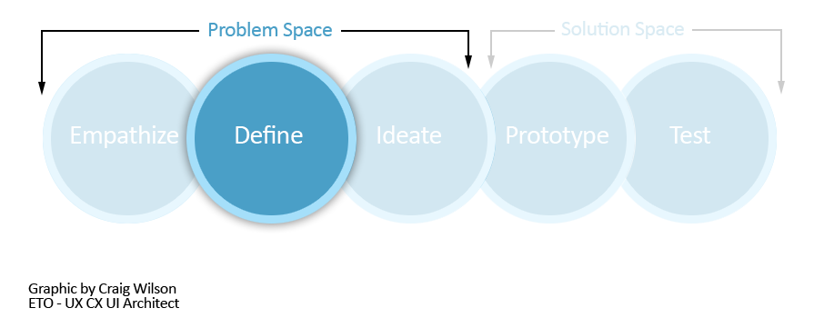
Stage 2 : Define
During the Define stage, we put together the information we have created and
gathered during the Empathize stage. We analyze our observations in order to define
core problems that we and our team have identified up to this point. We should
seek to define the problems using problem Statements.

Slide 9
Stage 2 : Define continued…
Instead of defining the problem as your own wish or a need of the company such as,
“We need to increase Anytime Interest Checking accounts among teenagers by 15%,”
a much better way to define the problem would be, “Teenagers need our Anytime
Interest Checking account in order to successfully achieve their financial goals.”

Slide 10
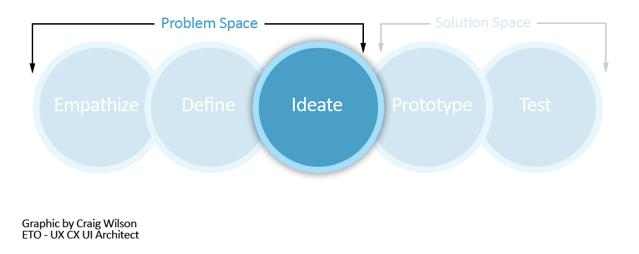
Stage 3 : Ideate
During the third stage of the Design Thinking process, designers are ready to
start generating ideas. We’ve grown to understand our users and their needs in
the Empathize stage, we’ve analyzed and synthesized our observations in the
Define stage, and have created human-centered problem statements. With this
solid background, our team members can start to 'think outside the box' to identify
new solutions to the problem statement/s we’ve created.

Slide 11
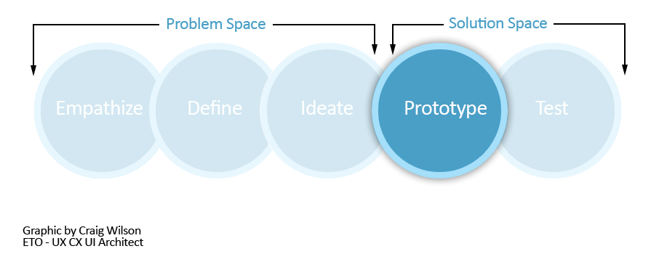
Stage 4 : Prototype
From here the design team will now produce a number of inexpensive, scaled down versions of the product or specific features, so they can investigate the solutions generated in the previous stages. The goal is to identify the best possible solution for each of the problem
statements identified during the first three stages. These solutions are implemented within prototypes and, are investigated, re-examined and improved, or rejected on the basis of the user feedback. By the end of this stage, the design/dev teams will have a clearer picture of how real a user behaves, thinks, and feels when interacting with these prototypes.

Slide 12
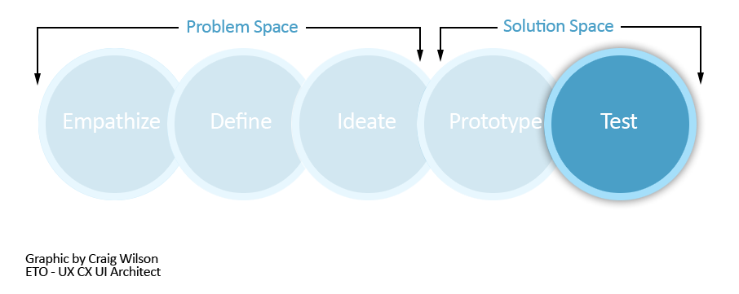
Stage 5 : Test
QA evaluators rigorously test the solutions we’ve created using the best solutions identified during the prototyping phase. The results generated during the testing phase are often used to redefine one or more problems. During this phase, alterations and refinements are still made in order to fix any issues or problems. We make adjustments derived from our deep understanding of our products and the needs of our users that we’ve gained during the Design Thinking process.

Slide 13
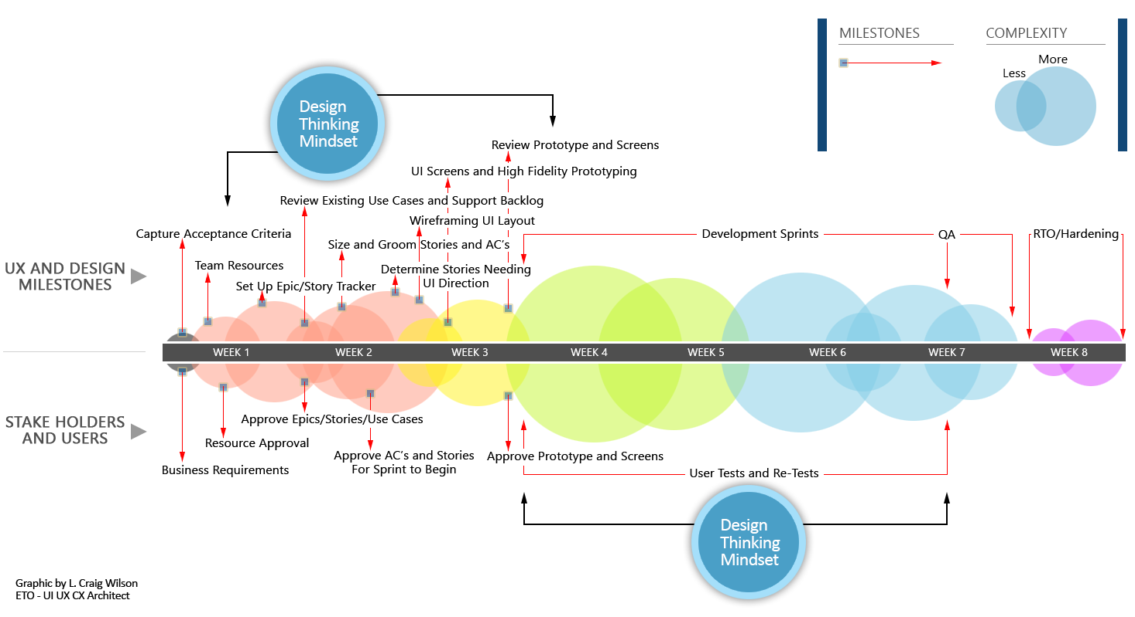
Agile : 8 Week Release Cycle Example

Slide 14

Questions

